Slide 1

External Analysis
Components of the External Environment

Slide 2
Business Strategy and Innovation
External Analysis
Objectives
To explore classical, conceptual frameworks and models which will assist the student in analyzing competitive situations and strategic dilemmas.
To develop an understanding of the impact of external factors - both local and global - on business strategy

Slide 3
Business Strategy and Innovation
External Analysis
Lessons
Components of the External Environment and How They Affect Strategy
Analyzing Macro-Forces – The PESTEL Framework
The Structure-Conduct Performance Continuum
Analyzing Industry Structure – The Five Forces Model
The Strategic Role of Complements
Strategic Groups and Competitor Analysis
Notes:
Keep all of the original transitions as is in the video. This is the only slide that is different. Only minor change to wording in the slides.

Slide 4
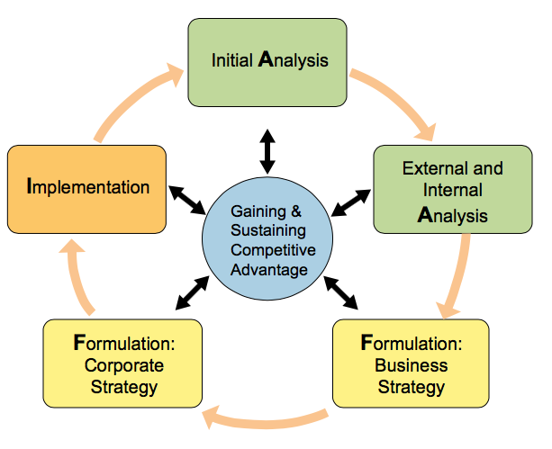
External Analysis The AFI Framework
A
F
I
nalsis
vision, mission, values, external and internal analysis
corporate, business, and functional strategy
ormulation
structure, culture, processes, capabilities technology, governance and controls, and business ethics
mplementation

Slide 5


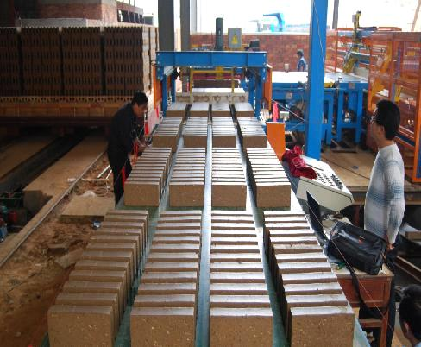



The Organizational Environment
Legal/
Regulatory/Ethical
Political
Industry
Competitors
Direct
Competitors
Substitutes
Technology
Ecological
Suppliers
Customers
Economic
Sociocultural/Demographic
Community
Notes:
At the outer-most level
of the firm's external environment is the
macro-economic environment in which the firm operates.
At this level, the firm has limited influence or impact.
On its own,
a firm cannot significantly affect these factors,
but the performance of the firm
itself can be greatly impacted.
Probably the most common categorization
defines these macro-forces into political,
economic, social, cultural, and demographic,
technology, ecological, and legal ethical components.
These factors should not be seen as independent factors.
Many times, factors become inter-related in affect.

Slide 6
External Analysis

Slide 7
External Analysis
The PESTEL Framework – Part 1

Slide 8
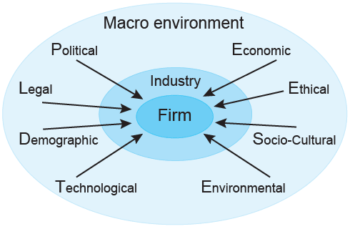
The PESTEL Framework
PESTEL: Political, Economic, Socio-Cultural, Technological, Ecological, and Legal
Key forces in the external environment
  Simple way to categorize & analyze external forces
  Forces embedded in global environment
  Largely uncontrollable at the firm level
  Creates BOTH strategic opportunities and threats
Notes:
The objectives of performing a PESTEL analysis are to,
one, to identify the external factors that most directly impact the firm.
Two, research and analyze how relevant forces are trending to
the extent that predictions can be made regarding future outcomes.
Three, identify opportunities and threats based on
predicted futures that can potentially impact firm performance.
A PESTEL analysis will give managers a much better understanding of the industry,
and the overall outlook for the future industry performance.
Also, the results of a PESTEL analysis can be used to determine key macroeconomic
variables used to structure scenarios,
in a sedarial planning approach to strategy formulation.
In order to perform a PASTEL analysis, managers have to gather as much
relevant information as possible about the firm's external environment.
Most of the information can be found on the internet with little cost.
This form of research is referred to as secondary research.
In some cases, primary research may be performed,
usually be tasking consultants or staff of addressing specific research questions
that may involve specialized or informed judgements.

Slide 9
PESTEL
Political
Governments Influence the Behavior of Firms:
Subsidies
Favorable Tax Policies at Local, State and Federal Level
Regulated Access or Pricing Controls
Grants and Other Investments
Trade Controls/Import Restrictions
Variables
Primary
IMPACT
Underwrites emerging technologies encouraging R&D
Opens or restricts access to markets by creating or eliminating barriers to entry

Slide 10
PESTEL
Economic
Variables
Primary
IMPACT
Growth Rates
Interest Rates
Inflation Rates
Cost of Capital
Levels of Employment
Price Stability
Currency Exchange Rates
Increases/decreases disposable consumer and discretionary business income and spending.
Can impact types of goods or services provided. Examples: buyers look for products that can reduce operating costs during economic contractions; higher ROI thresholds for capital project approvals

Slide 11
PESTEL
Socio-Cultural/Demographic
Society’s culture norms and values and demographics: life expectancies; aging population; changes in ethnic composition; immigration, work force diversity; rising affluence, increasing lifestyle changes, societal values; attitudes towards product classes, quality, safety, the environment
Variables
Primary
IMPACT
Impacts what consumers want to buy
Impacts market sizes
Increasing management complexity of a diverse workforce – accommodating cultural and gender differences in the work force.

Slide 12
External Analysis
The PESTEL Framework – Part 2

Slide 13
The PESTEL Framework
PESTEL: Political, Economic, Socio-Cultural, Technological, Ecological, and Legal

Slide 14
PESTEL
Technological
Relentless application of knowledge to create new products and processes
productivity improvements
IP protections
industrial spending on R&D
digital communications
emerging industries
technology transfer
Variables
Primary
IMPACT
Technology is an enabler of new business models, business processes, new products, and services. Can be efficiency driven, product sustainable or disruptive in character

Slide 15
PESTEL
Ecological
Ecological
Broad environmental issues such as waste and water management, clean air, alternate energy, workforce health plus society’s changing view of business responsibility
Key Words: Carbon Footprint, Global Warming, Air and Water Pollution, Toxins in Food and Other Consumer Products
Variables
Primary
IMPACT
Can affect buyers choice of procurement partners - accountable sourcing - and brand image.
Potential for increased government regulation of operational and transportation processes
Employee engagement

Slide 16
PESTEL
Legal/Ethical
Legal
Laws, mandates, regulations and court decisions
Hiring and Promotion Laws (EEOC)
Anti-Trust Regulations
Environmental Protection Laws
Tort Reform
Industry Regulation/Deregulation
Data Security
Intellectual Property
Variables
Primary
IMPACT
Typically create limitations in business marketing and operational practices.
Increased operational costs.
Can create entrepreneurial opportunities for new and existing firms.

Slide 17
PESTEL
Ignore
Strategy
Strategy
High
Medium
Low
Probably of Occurrence (y)
Ignore
Monitor
Strategy
Ignore
Ignore
Monitor
Low Medium High
Impact (x)
Notes:
One way to develop insights from a PESTEL Analysis and to establish priories for further analysis as well as strategy formulation is to construct a simple framework like the 3 x 3 matrix shown in this slide. To build the framework consider the x axis being a continuum of IMPACT to the firm, and the Y axis being a continuum of probability of occurrence. In this 3 x 3 the middle frame would be for trends or factors that have a moderate probably of happening with a moderate impact on firm performance (if the trend did materialize). The uppermost right frame would be for high probably, high impact trends, with the lower left frame reserved for low probably, low impact trends. Since in strategy formulation we have limited resources and limited timeframes to perform analysis a table like this would help bring focus to the planning team.
ADVANCE POWERPOINT
For example we would likely chose to ignore any trend or factor with a low or no impact on firm performance or any factor or trend with a low probability of occurrence with only a moderate likely impact.
ADVANCE POWERPOINT
Factors or trends with a high probably of occurrence that either moderately or highly impact firm performance would represent opportunities or threats as would a high impact factor with only a moderate probability of occurring.
ADVANCE POWERPOINT
The remaining factors or trends would be monitored to determine if the probably of occurring increases thus resulting in a new opportunity or threat to be dealt with.
The next slide illustrates this framework by using an example from a hypothetical transportation company
ADVANCE POWERPOINT

Slide 18
PESTEL EXAMPLE
Customers Attitude
Shifts Towards
Buy American (+)
GNP Growth Less
Than 3% (-)
Drone Usage for Private Business
Approved by FAA (+)
High
Medium
Low
Increasing tensions
Between US Government and Supply Chain Country (-)
Battery life technology
breakthrough dramatically improves storage capacity and recharge times (+)
Price of Oil Exceeds $100/Barrel (-)
Probably of Occurrence
New Republican Administration
Lowers Tax Rate for Business and
Individuals (+)
New Federal Mandate on
Green Vehicles (-)
Driverless Cars
Becomes Mainstream (+)
Low Medium High
Impact

Slide 19
PESTEL

Slide 20
External Analysis
The Structure-Conduct Performance Continuum

Slide 21
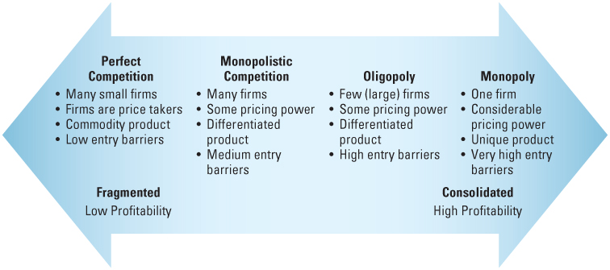
Industry Structures Along the Continuum
Source: Strategic Management Concepts and Cases by Frank K. Rothaermal
Notes:
In this video, we're going to discuss the SCP model of strategy.
The structure conduct performance model of strategy assumes that
structure determines firm conduct, which in tern drives firm performance.
In this framework, the term structure refers to industry structure
measured by such factors as the number of competitors in an industry,
the heterogeneity of products and the cost of entry and exit.
Conduct refers to specific firm actions in an industry including price setting,
product differentiation and innovation and exploitation of market power.
Performance in the SCP model has two meanings.
The performance of individual firms and performance of the industry as a whole.

Slide 22
The Structure-Conduct-Performance Framework
Examples
Agriculture
Pet Supply Stores
Dry Cleaners
Universities and Colleges
Food Retail
Residential Construction
Soft Drinks
Tobacco Products
Overnight Mail Delivery
Public Utilities
Telecommunications Carriers
Implications
Passive Price Takers, No Ability to Differentiate
Products have unique features and price differentiation is possible
Marketing firm strategies are interdependent
Accrue significant market power
Perfect Competition
Monopolistic Competition
Oligopoly
Monopoly

Slide 23
The Structure-Conduct-Performance Framework

Slide 24
External Analysis
Introduction to The Five Forces Model

Slide 25
Porter Five Forces Model
Porters Five Forces Model identifies 5 competitive forces that managers consider when analyzing the external environment and formulating strategy.
Collectively these forces provide industry structure – industry structure can work to constrain or enhance firm profitability. Typically one or two forces will be dominant
As a rule of thumb, the stronger the industry forces, the lower the industry profit potential – making industries less attractive. The reverse is also true.
Notes:
In this lesson we are going to discuss one of the most recognized frameworks in
the field of industry analysis as strategy, the Porter five forces model.
Taught in business schools and
practiced by firms everywhere since the early 1990's, this framework has
that fundamental element in the AFI approach to strategy development.
In developing the model, Michael Porter leveraged the SCP model, and
identified five forces which he suggested determined the competitive intensity and
therefore the attractiveness of an industry.
In the Porter model five forces provide structure in which the various firms
compete within the industry.
The forces include the nature of the competitive rivalry, the power that can be
exerted by either suppliers or customers over the industry competitors,
and the threat of competition from outside the industry.
In developing the Porter analysis, the stronger the force,
the greater the downward pressure on industry gross margins.
Also as a general rule in determining industry attractiveness, one or
two forces will have an ordinate impact.

Slide 26
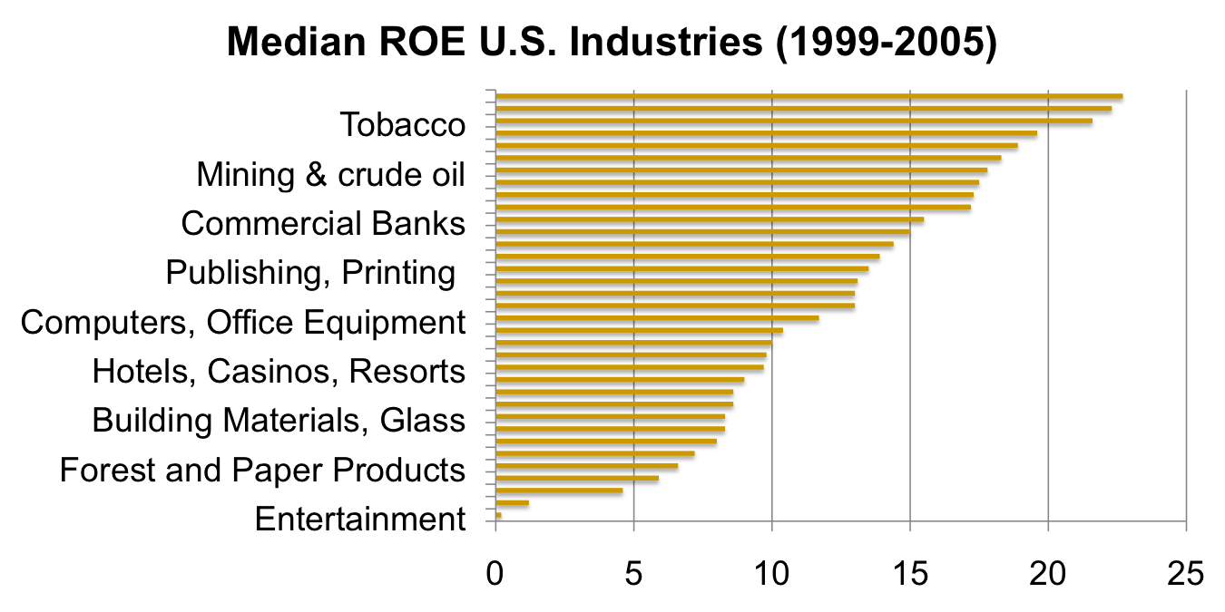
Industry Attractiveness
Porters 5 Forces Model
Source: Strategic Management Concepts and Cases by Frank K. Rothaermal

Slide 27
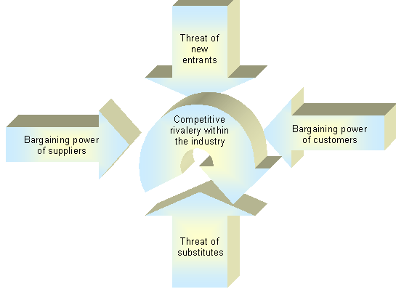
Porter Five Forces Model
Porters 5 Forces Model
Power Alignment
Composite Competition

Slide 28
Porter Five Forces Model
General Considerations
Concentration (CR)
Switching Costs
Forward and Backward Integration
n
Notes:
The concentration ratio is calculated for
an industry by aggregating the market shares of the top industry competitors.
There are a number of concentration ratios but
the most common is referred to as a CR4.
The CR4 is to combine market share of the four largest competitors in an industry.
Another measure, the CR8 is to combined market share of the top eight competitors.
At we have a CR16, CR32, and others.
A concentration ratio of 0 to 50%
is commonly interpreted as an industry with low concentration.
Monopolistic competition falls in the lower portion of this range
of oligopoly emerging near the upper end.
A concentration ratio of 50 to 80% is considered
an industry with medium concentration.
These characteristics are very much oligopoly in character.
An industry with a concentration ratio of 80 to 100%
is viewed as highly concentrated.
Government regulators are usually most concerned with industries fallen into
this category.
The second concept is that of switching costs.
Switching costs are the non-product related costs that a consumer or
business incurs as a result of changing suppliers, brands, or products.
Most switching costs are financial in nature, but
they're also psychological, effort, and time based costs as well.
Switching costs follow the three broad categories, redundant investments,
disruption risk, and contractual penalties.
The third concept is forward and backward integration.
Backward integration occurs when a firm purchases or becomes its own supplier.
Often this is done to improve inefficiencies, to create cost savings, or
to capture profits taken by the supplier.
In contrast, forward integration is when a firm purchases or
builds its own distribution capabilities.
Here again the motive is to capture profits.
This time, those profits are taken by the distribution channel partners.

Slide 29
Introduction to the Five Forces Model

Slide 30
External Analysis
The Five Forces Model – Part 1

Slide 31
Porter Five Forces Model
Notes:
Transition to this slide at :03 in the video

Slide 32
Porters 5 Forces Model
Bargaining Power of Suppliers
  Inputs into production processes include raw materials and components, indirect materials, labor, and services
  Suppliers can suppress the profitability of the industries to which they sell by raising prices or reducing the quality of the components they provide.
  If a supplier reduces the quality of the components it supplies, the quality of the finished product will suffer, eventually resulting in lower prices.
  Important Factors
    Size/Concentration
    Forward Integration
    Available Substitutes
    Buyer (customer)
    Price Sensitivity
    Switching Costs
Notes:
Once you understand the framework,
the process to develop a Porter analysis can be performed in three steps.
The first step is to gather the information on each of the five forces.
In the second step, you analyze the results,
usually by developing a Porter diagram similar to the one shown on this slide.
And then the third step is to prepare to formulate strategies based on your
conclusions.

Slide 33
Porters 5 Forces Model
Bargaining Power of Buyers
  Buyers (customers) can suppress the profitability of the industries from which they purchase by demanding price concessions or increases in quality.
  When buyers obtain price discounts, it reduces the firm’s top line and directly reduces profitability.
  Consumers as buyers have limited buying power – except the option not to buy or buy from a competitor. Business as buyers may have significant buying power. Example: Automobile Makers
  Important Factors:
    Volume
    Buyer Concentration
    Switching Costs
    Backward Integration
    Available Substitutes
    Product Standardization
    Importance of Price Paid
Notes:
Transition to this slide at 2:07 in the video then transition to full screen at 2:36

Slide 34
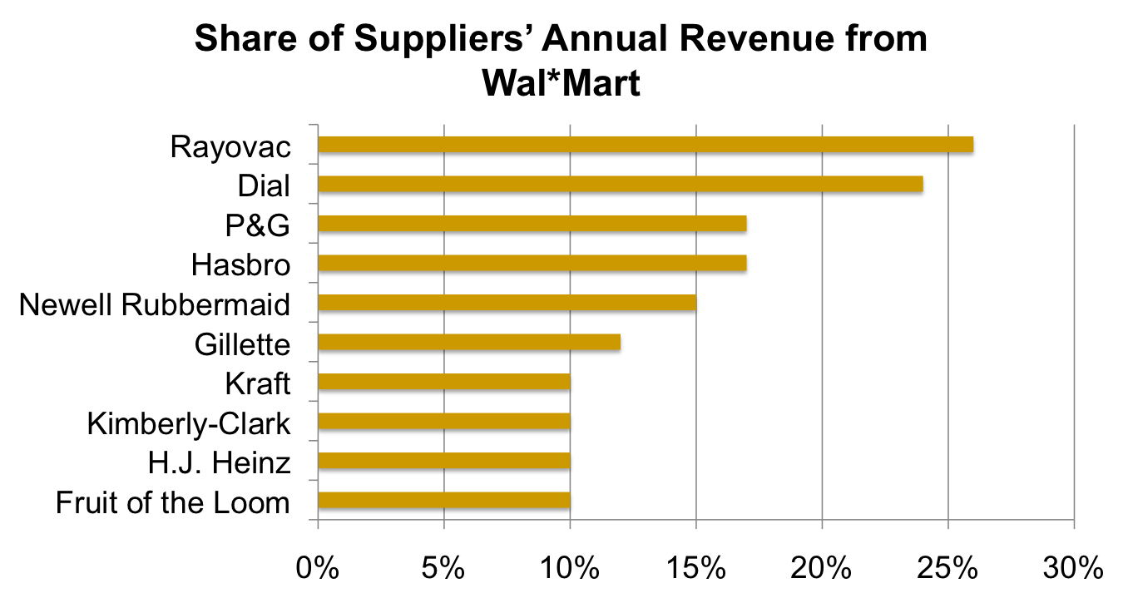
Bargaining Power of Buyers
Porters 5 Forces Model
Source: Wal-Mart annual report; USA Today
Notes:
Transition to this slide at 3:34 in the video

Slide 35
External Analysis
The Five Forces Model – Part 2

Slide 36
Porters 5 Forces Model
Threat of Substitutes
Threat of substitute products relates to how easily an industry’s customers can switch to an alternate product, one typically provided by a different industry.
In substitute industries, if competition rises or technology modernizes then prices and profits decline. Buyers can suppress the profitability of the industries from which they purchase by demanding price concessions or increases in quality.
  Important Factors:
    Number of Substitutes
    Switching Costs
    Performance of Substitutes
Notes:
Keep slide transitions exactly the same as in the original video

Slide 37
Porters 5 Forces Model
Threat of New Entrants
  If the firms in an industry are highly profitable, the industry becomes a magnet to new entrants.
  Unless something is done to stop this, the competition in the industry will increase, and average industry profitability will decline.
  Technology can level the playing field and bring barriers to entry down
  Firms in an industry try to keep the number of new entrants low by erecting barriers to entry.
    Capital Requirements
    Intellectual Property
    Government Regulation
    Switching Costs
    Product Differentiation (and Branding)
    Access to Distribution Channels
    Economies of Scale

Slide 38
Porters 5 Forces Model
Rivalry Among Existing Firms
  In most industries, the major determinant of industry profitability is the level of competition among existing firms.
  Some industries are fiercely competitive, to the point where prices are pushed below the level of costs, and industry-wide losses occur. In other industries, competition is much less intense and price competition is subdued.
  Factors that can determine rivalry:
    Concentration ratio
    Exit Barriers
    Growth Rate of Industry
    Product Differentiation
    Branding
    Switching Costs
    Economies of Scale

Slide 39
Porter Five Forces – Airline Industry
Powerful Suppliers
Powerful Buyers (Customers)
Strong Substitute Threats
Low to moderate Entry Barriers
Intense Rivalry
Unattractive PESTEL
RESULT: Low Overall
Profit Potential –
Unattractive for Investment
Notes:
Keep slide transitions timing exactly the same as in original video

Slide 40
External Analysis
The Five Forces Model – Part 3

Slide 41
Changing Industry Structure
Attractive Industry
Weaker Five Forces
High Profit Potential
Sustainable Competitive Advantage easier
Unattractive Industry
Stronger Five Forces
Low Profit Potential
Sustainable Competitive Advantage harder
Notes:
One result of a Porter Five Forces analysis
is that strategists can develop an understanding
of the fundamental structure and the dynamics of an industry
and ultimately stake out a position
that the firm believes creates the best opportunity
for profits as well as defenses against attack.

Slide 42
Changing Industry Structure
Abrupt Changes Driven by Macro-Forces
  Technological developments and innovation
  Significant regulatory (or deregulatory) change
  Change in customer behaviors
Changes in Structural Factors (Five Forces)
  Changes to barriers to entry
  Strategic decisions from non-competitors
  Increases/decreases in supplier/buyer power
  Shifting substitution threat
  New bases of rivalry
Structural Factors Can Be Shaped Through Strategy
  Each of the Five Forces are Subject to Influence
  Use tactics to increase value captured by the firm
  Larger competitors have a clear advantage here
Notes:
The point is that the real benefit
of performing a Porter Five Forces analysis
is not just to label an industry
as attractive or unattractive,
but it's identifying ways
that the firm can take advantage of industry structure.
Managers will have a general feel
for industry attractiveness
without doing a Porter analysis.
Instead the purpose is to develop industry insights.
Managers can also identify game-changing trends earlier
as well as identify ways
to work around industry constraints on profitability.
Importantly, a Porter analysis
can help reveal how an industry may be reshaped
to benefit the firm.

Slide 43
External Analysis
The Strategic Role of Complements

Slide 44
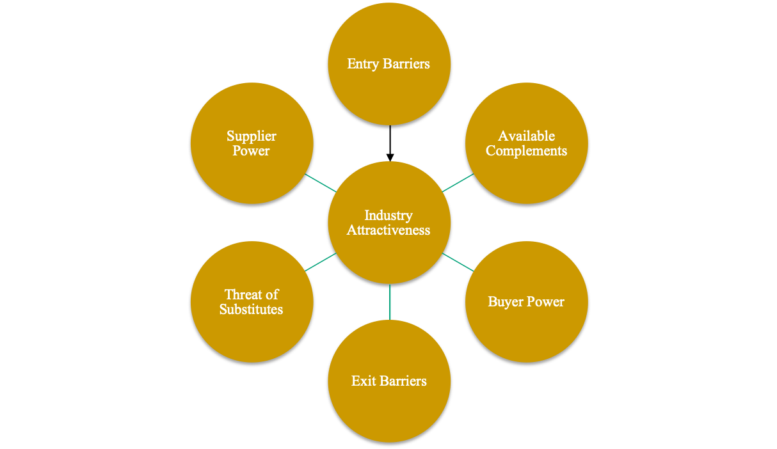
Adding a Sixth Force – The Strategic Role of Complements
A Complement is a product, service, or competency that adds value to the original product offering when the two are used in tandem
Source: Strategic Management Concepts and Cases by Frank K. Rothaermal

Slide 45
The Strategic Role of Complements

Slide 46
External Analysis
Strategic Groups and Competitor Analysis

Slide 47
Competitive Intelligence
  Competitor Information
    Who are our present and likely future competitors?
    What are the positions that the competitors have established in the marketplace?
    What are their strategic objectives and initiatives?
    What are their present and future strategies?
    What are their strengths and weaknesses?
    How are competitors likely to respond to our strategic initiatives?
  Approaches/Sources
    Websites
    Trade Shows
    Industry News
    Customers (of Competitors)
    Former Employees (be careful here)
    Consultants and Industry Databases
    The Firm as a Learning Organization
    SEC.gov Website (publically-held competitors)

Slide 48
Strategic Groups
A Strategic Group is a set of companies that pursue a similar strategy within a specific industry in their quest for competitive advantage. These firms target the same customer groups and with similar value propositions.
Strategic Groups can differ from other industry competitors along a number of dimensions: Product and Product Differentiation, Quality, Pricing, Technology, Service and Support, Research, Development, and Product Innovation, Distribution Channel, Target Customers.
Firms in the same Strategic Group are direct competitors. The rivalry with a Strategic Group is more intense than rivalry between Strategic Groups
Notes:
A strategic group is a group of firms within an industry
which face the same environmental forces.
Have same or similar resources and
follow a similar strategy response to the same environmental forces.
These strategies include pricing practices, product scope and skill and
product quality.
By identifying strategic groups, analysts and
managers are better able to understand the different types of strategies
that multiple firms are adopting within the same industry.

Slide 49
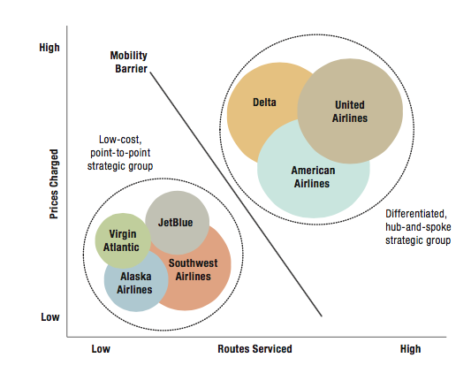
Strategic Groups
Source: Strategic Management Concepts and Cases by Frank K. Rothaermal
Notes:
A useful tool that can guide the separation of strategic groups in
an industry is called strategic group mapping.
This is a two by two matrix that helps to explain the different strategies of firms.

Slide 50
Strategic Groups
Competitive rivalry is strongest between firms that are within the same strategic group
Strategic groups are affected differently by the external environment
Some strategic groups are more profitable than other strategic groups
Strategic group can shift over as the needs of the customer or different technologies evolve
Notes:
In summary, strategic group creation and analysis provides an effective way to
develop a clear understanding of how firms within an industry compete.
Since each strategic group depicts firms with similar,
if not identical competitive attributes within the industry,
the map helps managers identify important differences among competitive positions.
These differences can be subject to further analysis to help explain more
subtle differences in performance.

